Slide 1

The Impact of Electric Vehicles on Air Quality
Database & Analytics Programming(MSCDAD_JAN23A_I)
Aravind Hallimysore Kalegowda(x22104275)
Rohan Kanagal Sathyanarayana(x19203829)

Slide 2

ABSTRACT
It is widely thought that an increase in the number of people driving electric vehicles (EVs) would result in lower levels of air pollution and will be beneficial to public health. The number of electric vehicles (EVs) already on the road as well as the primary sources of air pollution in a given area are two factors that influence the amount of air pollution that to what extent EVs are actually able to help in reducing the pollution . As a result, the purpose of this analysis and our usage of the data visualization helps to get a better understanding of how EV use impacts air quality. The air pollution dataset is unstructured (XML), but the electric vehicle population dataset is structured [source: https://catalog.data.gov/]. As a result, for the study, we utilized the two datasets. Following the data's transformation, we loaded it into PostgreSQL for visualization purposes after initially retrieving it from an API that was stored in MongoDB. This presentation will highlight the link between electric vehicles (EVs) and air pollution.

Slide 3
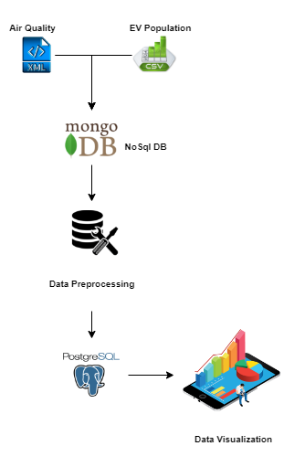
Project Flow
Step 1 : Reading the source data
Step 2: Loading Individual datasets to Mongo DB
Step 3 : Extract, Load, Transform
Step 4: Load the data to PostgreSQL
Step 5: Data Visualization
Step 6:Combine the datasets and loading it into PostgreSQL
Step 7:Visualisation [Analysis]

Slide 4
Dataset 1
While everyone in cities is exposed to air pollution to some degree, the emissions, levels of exposure, and vulnerability of the population vary greatly from one area to the next. Common air contaminants have been related to a variety of health problems, including asthma, heart disease, cancer, and early mortality. These data points give an overall picture of air quality and health in New York City across time and across different neighborhoods. The dataset represents information on the data collected during the surveillance of the air quality in New York City[source : https://catalog.data.gov] Air quality readings for pollutants were collected from the Department of Health and Mental Hygiene (DOHMH).
Transformation maneuvered : Defining the paths for easy extraction of the data from the hierarchy of the XML file
Creating a variable with empty list so that in next we can iterate through the element and store it in dataframe.
Data Loading -> Source -> MongoDB -> PostgreSQL
Visualization : Bar chart using Plotly for Gases along with health issues vs ppb mean value, AQI by year, Scatter plot for Pollutants according to year,Bar graph for Air quality index for top 15 locations , pie chart for Ozone (O3) pollution % across top 5 locations and pollution percentage and Volumetric ratio of pollution in air for top 4 locations

Slide 5
Dataset 2
As increase in air pollution and hike in fuel price people are moving towards electric vehicles. This datset has taken from DATA.GOV which shows the Battery Electric Vehicles (BEVs) and Plug-in Hybrid Electric Vehicles (PHEVs) that are currently registered through Washington State Department of Licensing. This includes useful information like county, state, model year, type of brands, different models of same brand, Electric vehicle type etc. This data gives the information about how the use of Electric vehicles are increased over the years and best Electric vehicle model in the current Market.
Data Loading -> Source -> MongoDB ->Transformation-> PostgreSQL
Transformation: Fetching CSV file from MongoDB and filling the null values and finding the age of vehicle based on the model year.
Visualization: Visualization is created to understand the information by looking in to graph from the data we have used. With help of Matplotlib and seaborn libraries created the bar graph for Number of EV’s vs state, top 10 Number of EV’s vs county, plot the Pie chart for make and models which gives information of % of the models in the make and models on the road, Scatter plot for model and city which tells us how the models distributed over cities, line plot for range vs model tells us range of models will be given and vehicle count vs model year tells us number EV’s on the particular year.

Slide 6
Combined dataset
Combined both dataset with common column called index further loaded it into PostgreSQL
Visualization : Bar graph for Electric Vehicle Population by year, air quality index by year vs EV_Year, Electric Vehicle Population by county, Electric Vehicle Population by Battery Type, scatter plot for Air Quality Index vs Number of Evs, box plot for Distribution of Air Quality Index by County , pie chart for Vehicle Count by county, heatmap for number of EV with respect to county and year , comparison chart for pollution level with respect to number of EV

Slide 7
Conclusion
Based on the analysis performed, from pie chart it was determined that Tesla was the most widely purchased model. NO2, O3, SO2 and other pollutants were found to be present in the atmosphere. In general, we concluded that there is a correlation between a rise in the number of electric cars and a decrease in the amount of pollution in the air. If we take comparison chart as an example and look at the year 2014, for instance, we can see that the number of electrical cars was high. As a direct consequence of this, the air pollution index witnessed a considerable decline in the year 2014. In a similar way, if we consider the year 2010, we can see that not only are there a greater number of electric cars already on the road, but there was also a noticeably lower level of pollution in the air in that specific year.

Slide 8

Thank you!

